Slide 1
WATER COMPACT
OBJECTION PROCESS
THINGS YOU NEED TO KNOW

Slide 2


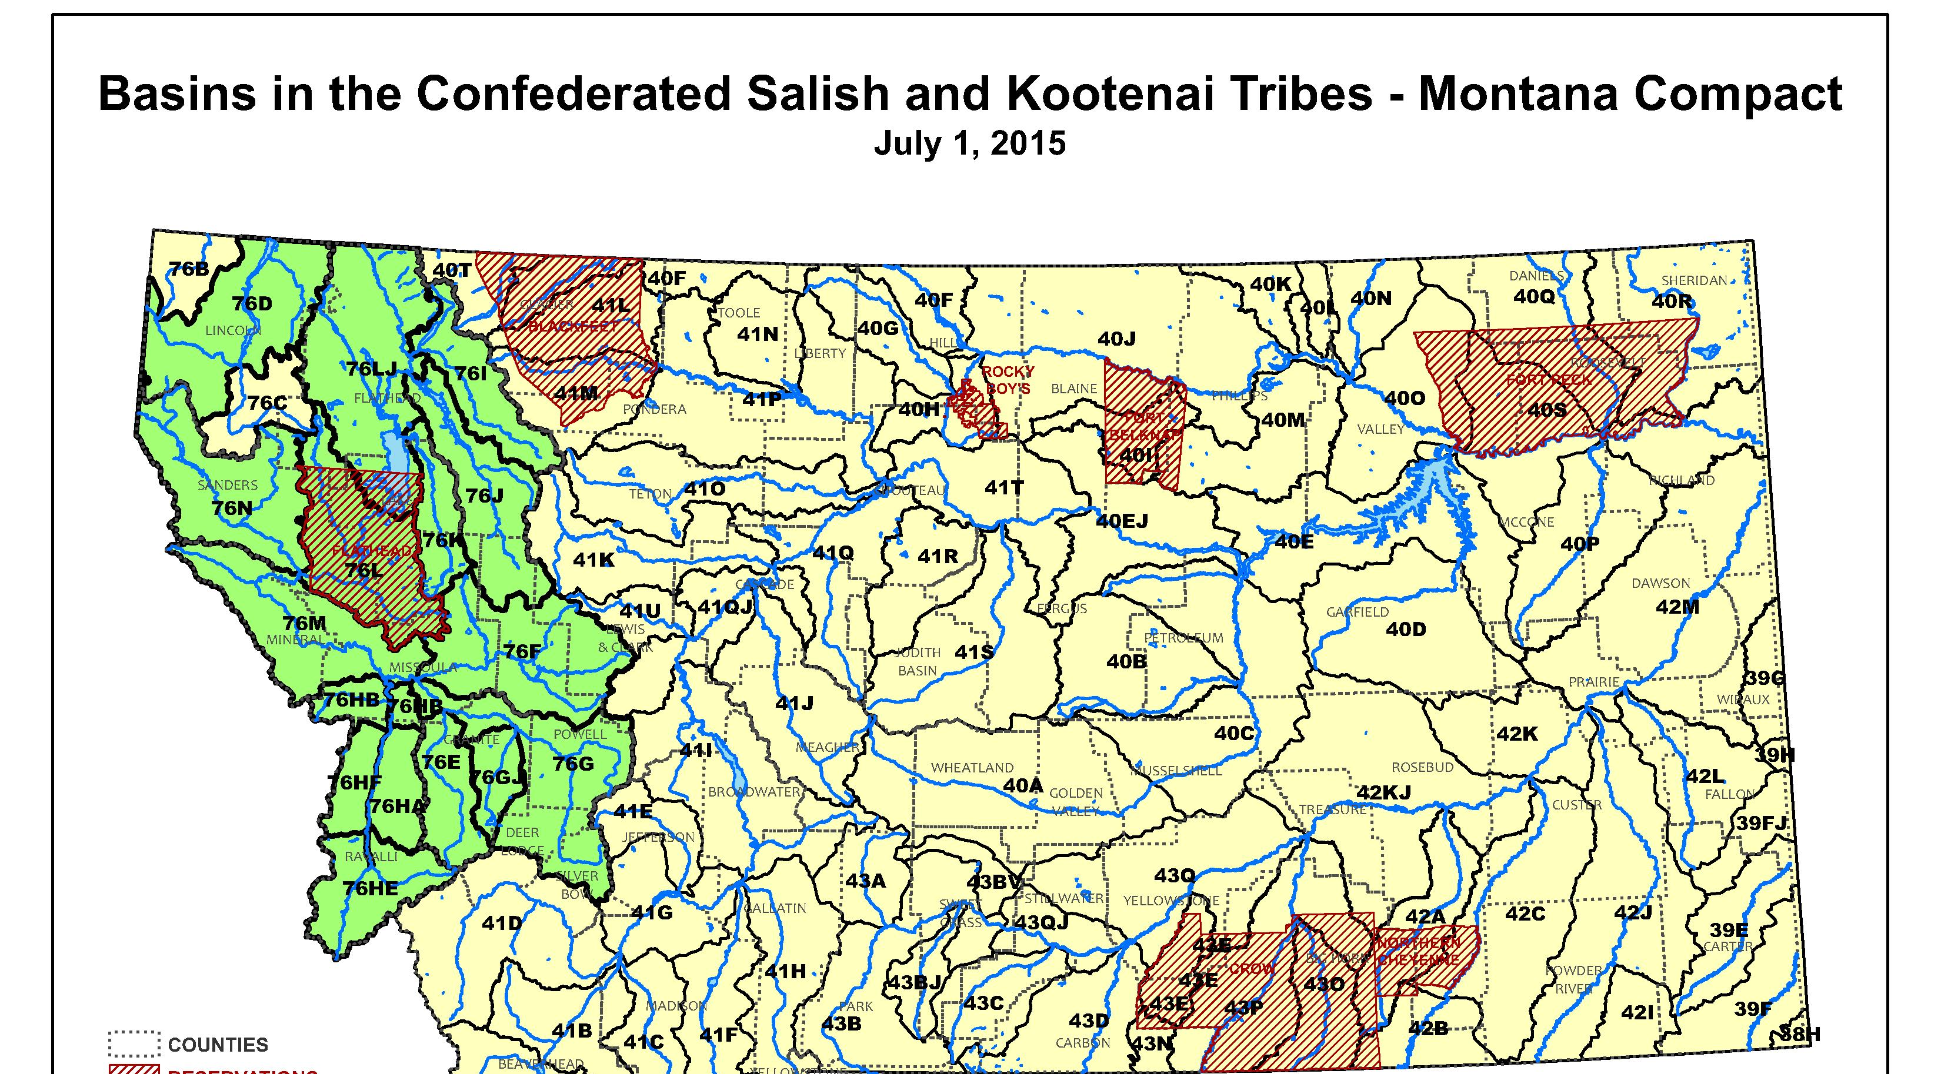

Slide 3
*NOTICE OF ENTRY OF THE CONFEDERATED SALISH AND KOOTENAI TRIBES OF THE FLATHEAD RESERVATION-STATE OF MONTANA-UNITED STATES COMPACT
PRELIMINARY DECREE AND NOTICE OF AVAILABILITY, Filed June 9, 2022 In The Water Court of the State of Montana, Confederated Salish and Kootenai Tribes-Montana-United States Compact, Case No. WC-0001-C-2021

Slide 4
Water Court has exclusive jurisdiction over adjudication of water rights claims. The Water Court issues preliminary decrees based on statements of claim, data submitted by departments, compacts and any additional data obtained by the water judge.
MCA § 85-2-231(2).

Slide 5
A decree is the final product of a basin adjudication. To reach completion, a decree progresses through several stages: examination, temporary preliminary/preliminary decree, public notice, hearings, and final decree.
MCA Title 85, Chapter 2, Part 2

Slide 6
Final decrees of the Montana Water Court may be appealed to the Montana Supreme Court. In order to appeal a final decree, a claimant must have objected to the preliminary decree or the claimant's water rights must have been altered after the issuance of the preliminary decree. All water rights not addressed in the final decree are considered forfeited under state law.
MCA § 85-2-235.

Slide 7
It is important that persons who are entitled to file an objection do so if they believe there is a problem with a claim. By failing to file an objection in an earlier decree phase, the person may be excluded from filing an objection at a later date.
MCA § 85-2-233(1)(d).

Slide 8
The Montana Court’s review of a compact allows the Court “to reach a reasoned judgement that the agreement is not the product of fraud or overreaching by, or collusion between the negotiating parties…” Chippewa Cree Tribe Water Compact, 2002 WL 34947007, *3, Case No. WC-2000-01 (June 12, 2002).

Slide 9
The purpose of the review is to ensure that the agreement is fair and reasonable to those parties and the public interest who were not represented in the negotiations, but have interests that could be materially injured by operation of the compact.
Id. at 4*.

Slide 10
With regards to the CSKT Preliminary Decree, interested persons must state any objections they have and request for a hearing must be filed and received by the Montana Water Court on or before December 6, 2022, or risk losing the right to object to the Preliminary Decree.*

Slide 11
Per the Montana Water Court objection format, the objection should identify the parts of the CSKT Preliminary Decree which a party is objecting to and identify the specific grounds and evidence upon which the objection is based.*

Slide 12
If a party is objecting to a specific water right the party should identify the water right by number, Preliminary Decree page number and the applicable water source. If a party is objecting to more than one water right the Form directs one should use a separate form for each water right number.*

Slide 13
Late objections received and/or filed after December 6, 2022 will not be considered.*

Slide 14

THE WATER COURT OBJECTION TOOLBOX
Individual landowner Info Needs patent & land ownership proof, water right number, property description, maps, history
Preliminary Decree and Appendices 1 & 2; Compact and all appendices, maps for location of your right in relation to Compact water claims
MT Water Court Letter and Instructions
INDIVIDUAL QUESTIONS
Is my water right impacted by the Compact claim or its operation?
  Water Supply
  Drought Year issues
  For irrigation wells more than 100 gpm, risk of call
Is my right to use water impacted by the “operation of the compact”, e.g., the decisions of the Flathead Management Board?
GENERAL OBJECTIONS
The process of limiting the court’s review to appendix 38
Other?

Slide 15
WHAT YOU NEED TO PROVE IN THE WATER COURT
This Preliminary Decree is a decree entered by the Water Court in accordance with § 85-2-231(2), MCA. As explained in Article VII.B.2 of the Flathead Compact, the Water Court’s review of the Compact is “limited to the contents of Appendix 38 [of the Compact] and may extend to other sections of the Compact only to the extent that they relate to the determination of water rights and their administration.”
The Preliminary Decree sets forth the entire Flathead Compact and the specific provisions of the Flathead Compact that the Court will review in the proceeding. The Court’s review will be conducted pursuant to the standard previously identified for the review of Tribal-State water compacts, which treats a compact as “closely analogous to a consent decree.” Chippewa Cree Tribe Water Compact, 2002 WL 34947007, *3, Case No. WC-2000-01 (June 12, 2002).
The Court’s review of a compact is to allow the Court “to reach a reasoned judgment that the agreement is not the product of fraud or overreaching by, or collusion between the negotiating parties . . . .” Id. (internal quotations omitted).
“The purpose of this kind of judicial review is not to ensure that the settlement is fair or reasonable between the negotiating parties, but that it is fair and reasonable to those parties and the public interest who were not represented in the negotiation, but have interests that could be materially injured by operation of the compact.” Id. at *4 (emphasis omitted).

Slide 16
OUTLINE OF MONTANA WATER RIGHTS ACCORDING TO DATE
Pre-1973. These are to be affirmed in the MT Water Court per the MT Constitution
Post 1973. Considered a new appropriation. Must have been filed to DNRC by 1986
Post 1996. known as “Post-Ciotti”-decision water rights filed with DNRC—
  These “went into the drawer” in Kalispell and have been transferred to Helena DNRC.
  IMPORTANT: For Post-Ciotti people, your water rights are not ‘visible’ to the Water Court. MEET US AFTER THE MEETING FOR OBJECTION INFO!
Ground Water Wells Post-1996: Did your driller submit records?

Slide 19
Information you must gather and file with your water right objection(s)
Legal description(s) of your property – property tax bill, deed
List of and copies of your Water Right Claims/Abstracts – call the DNRC
Description of your objection and how you are individually affected
Property maps – ask county offices for cadastral maps, GIS and cadastral maps available online
Acreage/crop production reports if applicable
Pictures – particularly of water sources, diversions, ponds etc.

Slide 20
The Court will review the objections. If the objecting party has shown good cause for the objection, the Water Court shall hold a hearing on any objection that cannot be informally resolved.
MCA § 85-2-233.

Slide 21
After resolving all objections and finally resolving all issue remarks, the Water Judge issues a final decree. Because the Water Judge adjusts existing rights during the adjudication process, the elements of a final decreed water right may differ from the original claim.
MCA § 85-2-234.

Slide 22
OBJECTION TIPS
Begin at the beginning. This is your history, what you have, what you do with it and what effect the Tribal Water Rights and the Administration of those rights will have on you.
Be advised that the Montana Water Court can only consider objections relating to “the parts of the compact that determine the Tribes’ Water Rights and their Administration”. (Pg. 1 Preliminary Decree)

Slide 23
A TOOLBOX FOR OBJECTIONS
3. Issues for objection can include:
  Volume --Acre feet, gallons, cubic feet
  Flow rate – Gallons per minute (GPM), Cubic Feet per second (CFS), Miner’s inch (MI)
  Priority Date – When was the water appropriated and used, or this may be operation of law with water set aside by law with water set aside by Act of Congress, Treaty, State Legislative Act or Court Decision. It is usually a date such as July 10, 2008. It is not the date a well was drilled but the day it was put to use.
  Place of Use – Where is the water used: a section, township and range, a lot on block one to City of Polson, or a Tract of Certificate of Survey. This is usually called POU.
  Point of Diversion – Location of a well, location of a headgate, location of a dam, vicinity in a larger parcel of land where horses drink. This is generally called POD.
  Ownership of claim – Who owns the water that is being diverted. This may be an individual, a State, the USA, a Tribe, or otherwise. There may be multiple owners.

Slide 24
A toolbox for objections
The items above may be tied to the history of the land, the history of the use of the land, the history of how the parcel of land was created and the history of the ownership of the property.
The history also applies to the history of the use of the water: when, where, why, how, and what for. Uses could include:
a. Domestic
  b. Lawn and garden (generally smaller scale)
  c. Irrigation
  Livestock
  Recreation
  Power generation: water wheel, electricity, baffle movement
  Navigation: float a boat, a canoe, a log.
  Riparian or wetlands preservation

Slide 25
A TOOLBOX FOR OBJECTIONS
6. An understanding of these aspects of your land and water should provide your basis for what things or aspects of Tribal Water Rights and their Administration will affect you.
  For example, if your land was allocated by a Tribal Member and then sold, you may want to consider an objection based on ownership if the conveyance of the land did not exclude the water. You will need to consider many things to frame any objections.
  Land records are in the Clerk and Recorder Office, the BIA Lands Office in Ronan or St. Ignatius and the BLM Lands Office in Billings. Complete records prior to 1923 may be in Missoula County Archives. This is a place to begin. If you complete this research soon you can craft objections by November for December filing.
  You may need to call the Title Company that did Title Insurance for you as they may have the records.
  In addition, talk to your elderly neighbors as they may know a great deal about history that is relevant to these issues.

Slide 26
OBJECTIONS TO FLATHEAD COMPACT
Three Parts
  Specific to YOUR WATER RIGHT—must go “first” in your packet. How does the compact impact your specific water right?
    Tribal or US time immemorial stream flow rights in time of drought
    Operation of the Compact— “ ground water well calls”, “permits”, water delivery, new uses, “co-ownership” and “co-management” of streams with MT Fish, Wildlife, and Parks, etc
  Objection to the process used by the Water Court (optional)
    Limited to Appendix 38 and “parts of the Compact that relate to the quantification of the Tribal Water Rights or their administration”
    Other elements missing to help inform your objection, such as visibility of your own information
  Fraud, Overreach, Collusion (optional)
    Overreach examples—off reservation water rights; “co ownership” of FWP water rights; Mt abandoning citizens
NOTE: All materials must follow format of Water Court with longer objections following the MT Rules of Civil Procedure (format of objection)

Slide 27
CRITICAL POINT TO REMEMBER
The Water Court will not consider an objection that consists ONLY of general objection to or disagreement with the Compact to be valid. You MUST present a SPECIFIC objection(s) based upon YOUR water rights as they legally exist today in order for your objection to be considered.

